Slide 1






ENERGY CONSUMPTION ANALYSIS INSIGHTS, METHODOLOGY, AND SAVINGS
NOTEBOOK LINK
DASHBOARD LINK
By gharam ahmed mokhtar

Slide 2

AGENDA
Introduction
Methodology
Key Challenges
Key Insights and Findings
Energy Saving Strategies
Conclusion & Recommendations
Q&A
01
02
03
04
05
06
07
08

Slide 3

INTRODUCTION
Content:
The aim of this analysis is to understand energy consumption patterns across different regions and times of the day.
We focus on identifying key factors that influence energy use and finding ways to optimize consumption and reduce costs.

Slide 4
METHODOLOGY
Content:
Data Collection: Energy consumption data was collected across various regions over different times of the day.
Data Cleaning: Removed missing values and handled outliers.
Threshold Calculation: The 25th percentile was used to define the low-consumption threshold for each region.
Statistical Analysis: ANOVA and Kruskal-Wallis tests were used to assess relationships between time of day, region, and energy consumption.
Price Calculation: Energy prices were calculated based on demand (High, Normal, Low), then converted to EGP.

Slide 5
KEY CHALLENGES
High Variability:
Insight: Energy consumption shows significant fluctuations across regions and times of the day.
2. Actionable Implication: This variability can complicate the task of managing energy usage, and thus we need targeted strategies to handl peak
consumption periods in specific regions.
3. Outliers:
Insight: There are occasional spikes in energy consumption, which could be due to factors such as the installation of new equipment or system
disruptions (e.g., faulty meters).
4. Actionable Implication: These outliers can distort the analysis and need to be either removed or adjusted to ensure more accurate results.
Anomaly detection techniques can be implemented to address these issues effectively.
5. Data Quality:
Insight: Missing or inconsistent data can be a significant problem, particularly in areas where meter readings are not recorded correctly or are
interrupted due to electricity outages.
6. Actionable Implication: Careful data cleaning and imputation techniques are required to handle missing values. Additionally, smart meters can
be used to reduce data errors.
7. DateTime Issues:
Insight: The DateTime column can sometimes be inconsistent or improperly formatted (e.g., missing time zones or incorrect time stamps). This
an lead to inaccuracies in time-based analyses, especially when aggregating data by time of day or date.

Slide 6
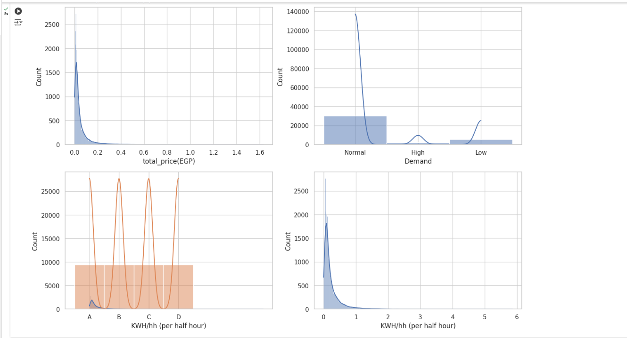
Visualisations columns in df:

Slide 7
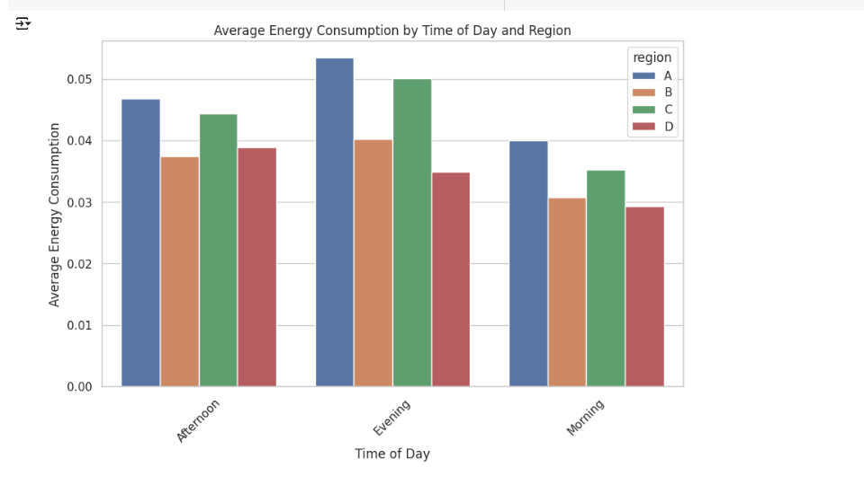
concolution:
The energy consumption in Morning and Afternoon periods may vary across different regions, but typically the Evening period tends to show a higher energy consumption due to increased activities like lighting and heating.
In some regions, the Morning or Afternoon periods show lower consumption as fewer activities may be happening, and the demand for energy could be lower during the daytime.

Slide 8
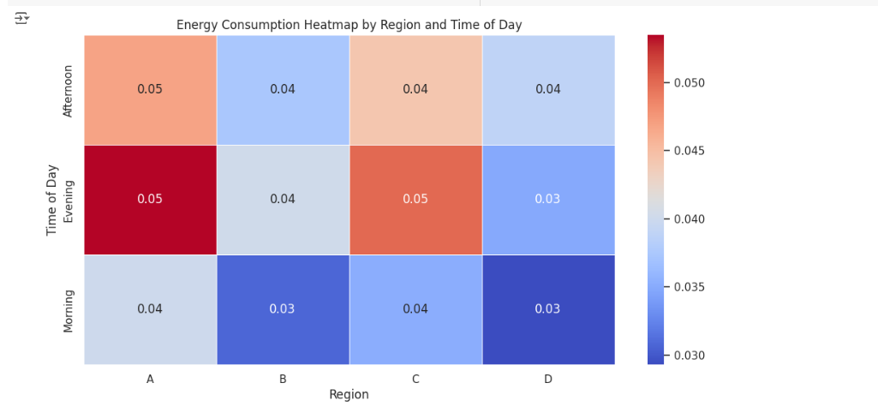
conclusion:
The energy consumption heatmap shows that the highest consumption occurs in the Evening in Regions A and C (0.05), while the lowest consumption is observed in the Morning in Regions B and D (0.03). Overall, energy usage peaks during the Evening, whereas it remains at its lowest in the Morning across all regions. Regions A and C exhibit higher energy consumption compared to Regions B and D, indicating increased energy demand in the evening due to higher activity levels during this time of day

Slide 9
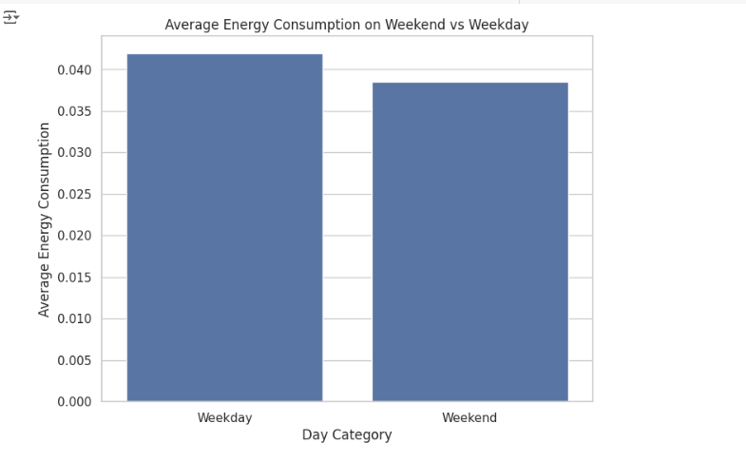
Feature Engineering / Adding new cols
Conclusion:
In essence, the higher energy consumption observed on weekdays compared to weekends can largely be attributed to increased working hours, commercial and industrial operations, and the more structured daily routines that require consistent energy use. Weekends, on the other hand, often have less commercial activity, fewer people working in offices or factories, and more energy-efficient patterns of consumption as people tend to be away from home or engage in outdoor activities.

Slide 10
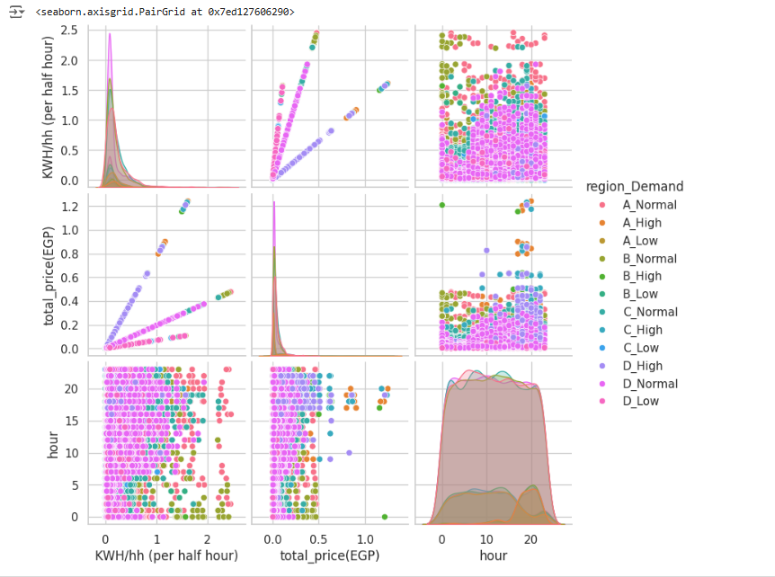
Feature Engineering / Adding new cols
concolusion: of the presentation for each region in relation to its consumption segment and how there is a difference in their appetite and

Slide 11
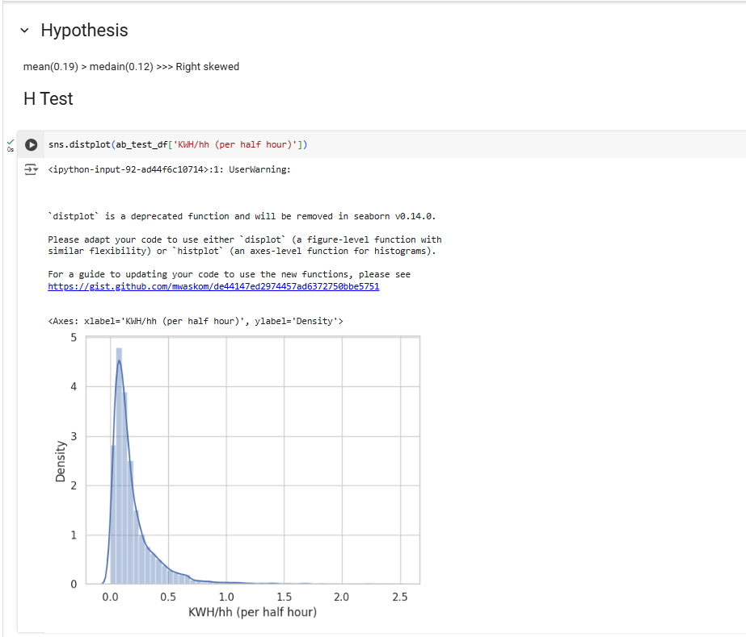
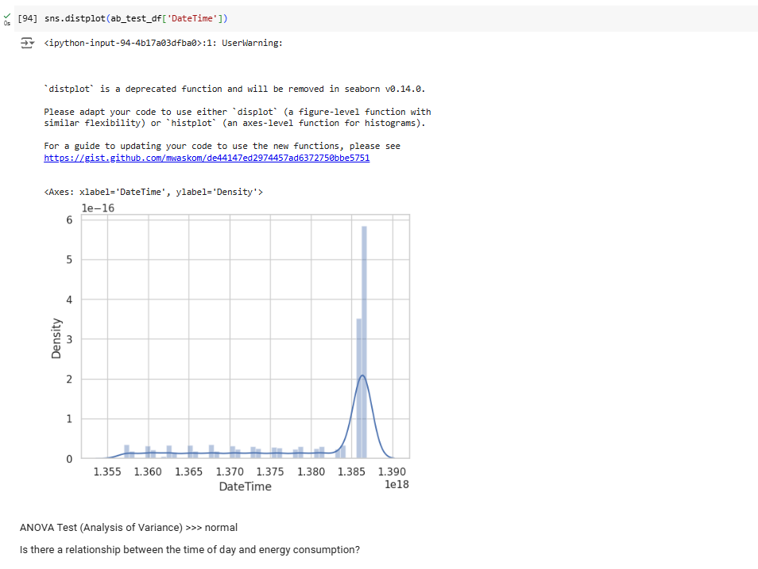

Slide 12
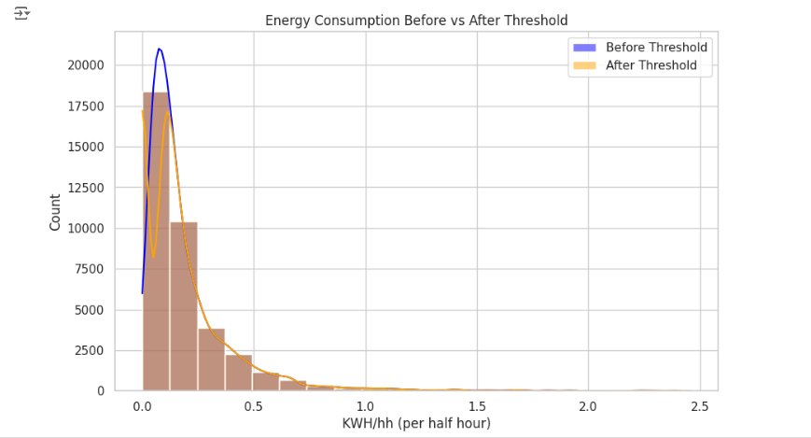

Slide 13
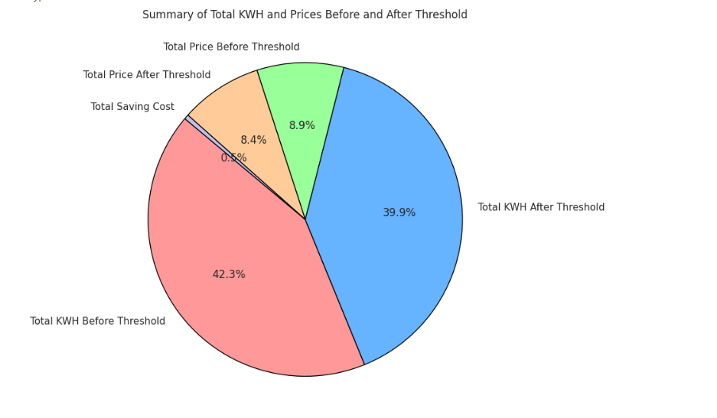

Slide 14
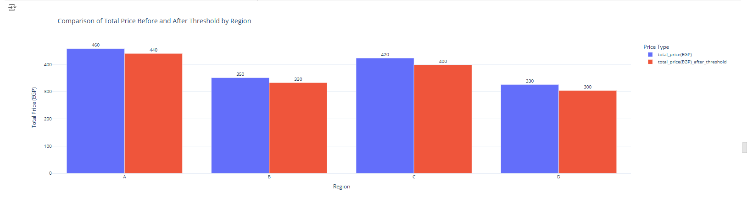

Slide 15
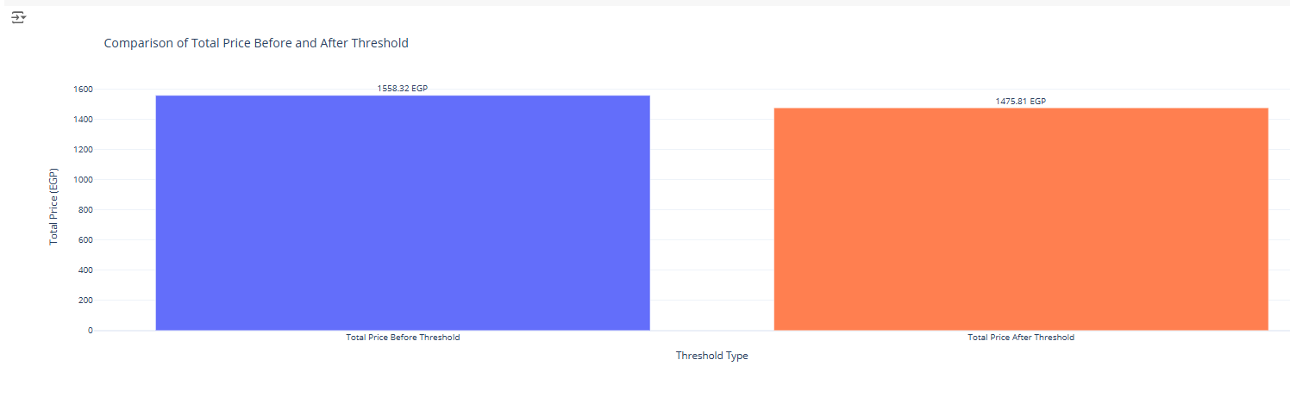

Slide 16
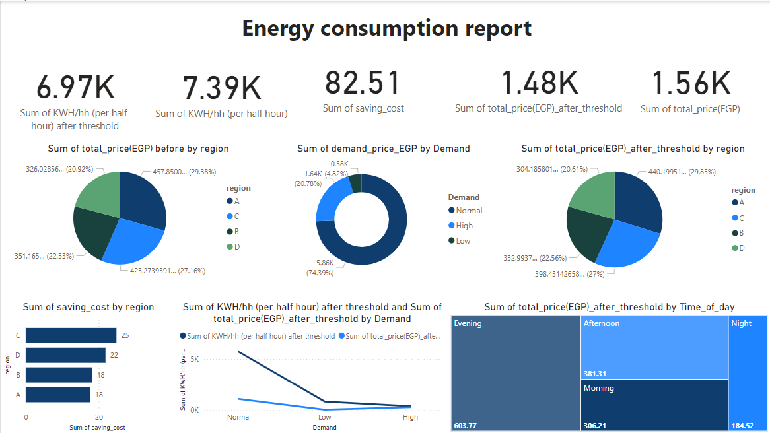

Slide 17
Summary of Key Insights
Regional Differences in Energy Consumption:
Insight: There are significant differences in energy consumption across regions.
Implication: Higher energy consumption in certain regions may be due to factors such as industrial activity, population density, or inefficient energy use. Actionable Insight: Further investigation is needed to identify the main causes of high consumption in specific regions. Implement targeted energy-saving initiatives in regions with high consumption to optimize energy use.
Energy Consumption During Peak Hours:
Insight: Energy consumption is significantly higher during peak hours (e.g., 9 AM to 5 PM) compared to night time.
Implication: Peak demand periods, often due to business operations and household usage, strain the energy grid and increase costs.
Actionable Insight: Demand-side management strategies should be implemented to shift energy consumption to off-peak hours. Additionally, time-of-use pricing can be introduced to encourage lower energy consumption during peak hours.
Cell Shutting for Energy Savings:
Insight: By shutting down low consumption cells, significant energy savings were achieved.
Implication: Identifying and shutting down non-essential cells during low consumption periods can help reduce overall energy demand and lower costs.
Actionable Insight: Expand this strategy by targeting cells or equipment that show consistently low energy consumption, and implement an automated system to shut down these units during non-peak hours.
4. Occasional High Energy Consumption:
Insight: Sometimes, there may be high energy consumption during a specific hour or half-hour due to factors such as the purchase of new equipment or the installation of an energy-intensive device. These devices may draw a significant amount of energy, causing temporary spikes in consumption.
Implication: This is normal behavior, as energy-hungry devices can lead to short-term increases in consumption.
Actionable Insight: It's important to track these events over time to distinguish between isolated incidents and recurring patterns. This can help prevent misinterpretation of data when analyzing energy consumption.
5. Electricity Outages or Meter Disruptions:
Insight: High consumption does not always indicate something wrong. Sometimes, electricity outages or meter disruptions (e.g., the meter being turned off) can lead to irregular readings or unexpected consumption patterns.
Implication: These instances should be taken into account when analyzing data, as they can artificially inflate consumption records.
Actionable Insight: Verification of the data source for inconsistencies such as power cuts or equipment issues will help improve the accuracy of the analysis. It is critical to filter out these disruptions to avoid incorrect conclusions about energy consumption behavior

Slide 18
CONCLUSION
The analysis revealed important insights into how energy consumption varies by region and time of day, highlighting opportunities for improvement through targeted energy-saving strategies. The challenges faced during this analysis, particularly regarding data quality, can be overcome with better data cleaning and validation techniques.
By applying the insights gained, it's possible to optimize energy usage, reduce costs, and make significant strides towards energy efficiency.

Slide 19
THANK
YOU

